Slide 1
Air Pollution Control

Slide 2
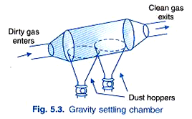
Gravitational Settling Chamber
It uses the force of gravity to remove solid particles.
The gas stream enters a chamber where the velocity of the gas is reduced. Large particles drop out of the gas and are recollected in hoppers. Because settling chambers are effective in removing only larger particles, they are used in conjunction with a more efficient control device.
gas velocity less than about 3 m/s
The gas velocity of less than 0.5 m/s will produce good results.
Curtains, rods, baffles and wire mesh screens may be suspended in the chamber to minimize turbulence and to ensure uniform flow. The pressure drop through the chamber is usually low and is due to the entrance and exit losses.

Slide 3
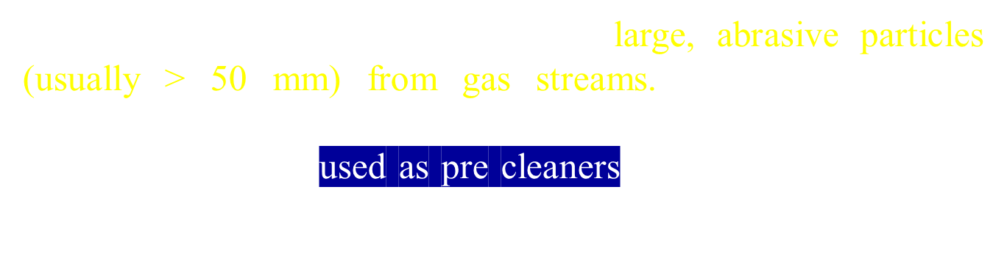
The velocity of the particles in the settling chamber can be obtained by Stokes' law as follows:
Vs = (g(ρp -ρ ) D² ) /18 µ
Where,
D = Diameter of the particle.
g = acceleration due to gravity
ρp = density of the particle
€ρ = density of the gas
µ = viscosity of the gas

Slide 4
The advantages of settling chambers are:
low initial cost,
ii) simple construction,
iii) low maintenance cost,
iv) low pressure drop,
v) dry and continuous disposal of solid particles,
vi) use of any material for construction, and
vii) temperature and pressure limitations will only depend on the nature of the construction material.
The disadvantages of this device are
large space requirements and
ii) only comparatively large particles (greater than 10 micron) can be collected.
iii)Because of the above advantages and disadvantages, settling chambers are mostly used as pre-cleaners.

Slide 5
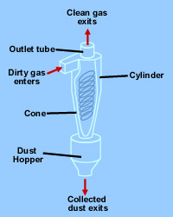
Cyclone Seperator
The general principle of inertia separation is that the particulate-laden gas is forced to change direction. As gas changes direction, the inertia of the particles causes them to continue in the original direction and be separated from the gas stream.
The walls of the cyclone narrow toward the bottom of the unit, allowing the particles to be collected in a hopper.
The cleaner air leaves the cyclone through the top of the chamber, flowing upward in a spiral vortex, formed within a downward moving spiral.
Cyclones are efficient in removing large particles but are not as efficient with smaller particles. For this reason, they are used with other particulate control devices.
Figure: Cyclone Collector

Slide 6
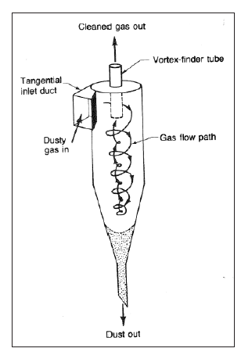
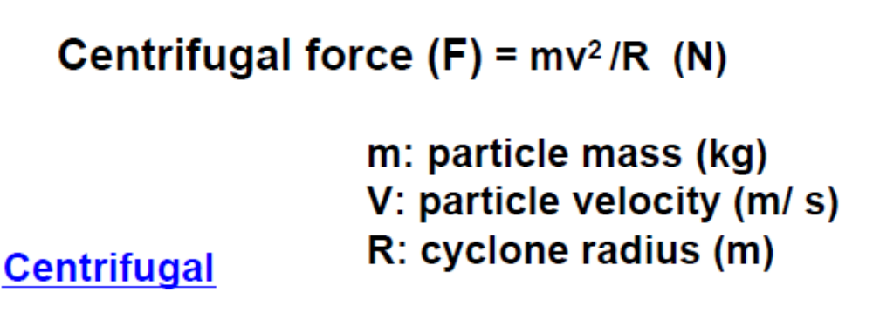
CYCLONES
Dust-laden gas is whirled rapidly inside a collector shaped like a cylinder where, the swirling motion creates centrifugal forces that cause the particles to be thrown against the walls of the cylinder and drop into a hopper below. The gas left in the middle of the cylinder after the dust particles have been removed moves upward and exits the cylinder.

Slide 7
The advantages of cyclones are:
i) low initial cost,
ii) simple in construction and operation,
iii) low pressure drop,
iv) low maintenance requirements,
v) continuous disposal of solid particulate matter, and
vi) use of any material in their construction that can withstand the temperature and pressure requirements.
The disadvantages of cyclones include:
i) low collection efficiency for particles below 5 - 10 µ in diameter,
ii) severe abrasion problems can occur during the striking of particles on the walls of the cyclone, and
iii) a decrease in efficiency at low particulate concentration.

Slide 8
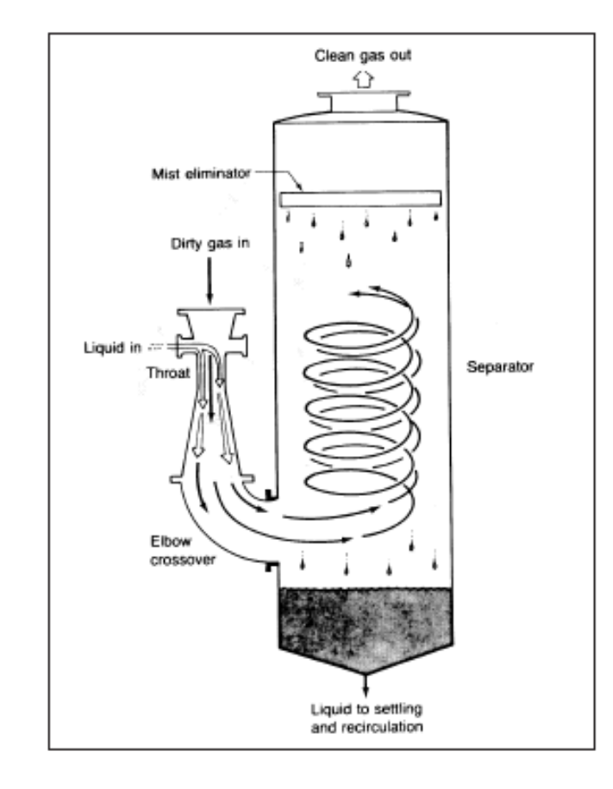
WET SCRUBBING EQUIPMENT
Water is directed into the gas stream either immediately before or at the venture throat. The difference in velocity and pressure resulting from the constriction causes many small and larger water droplets to form. These droplets then collide with the particulates and essentially stick to them. The reduced velocity at the expanded end of the venture throat allows droplets of water containing the particles to coalesce into larger droplets, which then drop out of the gas stream.

Slide 9
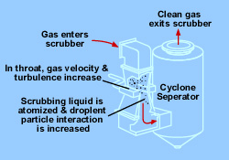
Venturi Scrubbers
Venturi scrubbers use a liquid stream to remove solid particles.
In the venturi scrubber, gas laden with particulate matter passes through a short tube with flared ends and a constricted middle.
This constriction causes the gas stream to speed up when the pressure is increased.
Figure: Venturi scrubber components

Slide 10
The advantages of scrubbers are:
i) Low initial cost.
ii) Moderately high collection efficiency for small particles.
iii) Applicable for high temperature installations.
iv) They can simultaneously remove particles and gases.
v) There is no particle re- entrainment.
The disadvantages of scrubbers are:
i) High power consumption for higher efficiency.
ii) Moderate to high maintenance costs owing to corrosion and abrasion.
iii) Wet disposal of the collected material.

Slide 11
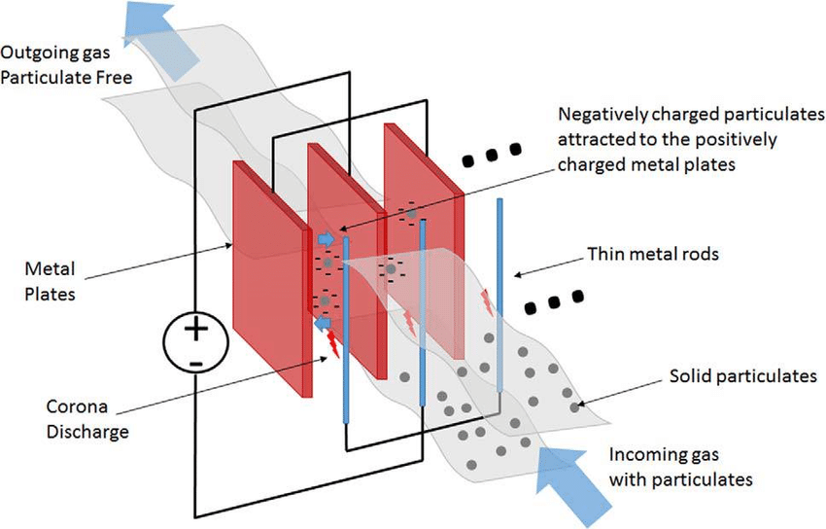
Electrostatic Precipitators (ESPs)
An ESP is a particle control device that uses electrical forces to move the particles out of the flowing gas stream and onto collector plates.
The ESP places electrical charges on the particles, causing them to be attracted to oppositely charged metal plates located in the precipitator.
Figure: Electrostatic precipitator components

Slide 12
Conti….
The particles are removed from the plates by "rapping" and collected in a hopper located below the unit.
The removal efficiencies for ESPs are highly variable; however, for very small particles alone, the removal efficiency is about 99 percent.
Electrostatic precipitators are not only used in utility applications but also other industries (for other exhaust gas particles) such as cement (dust), pulp & paper (salt cake & lime dust), petrochemicals (sulfuric acid mist), and steel (dust & fumes).

Slide 13
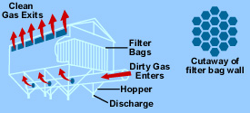
Fabric Filters
Fabric filters, or baghouses, remove dust from a gas stream by passing the stream through a porous fabric. The fabric filter is efficient at removing fine particles and can exceed efficiencies of 99 percent in most applications.
Figure: Fabric filter (baghouse) components

Slide 14
Filter bags usually tubular or envelope-shaped, are capable of removing most particles as small as 0.5µm and will remove substantial quantity of particles as small as 0.1µm.
Filter bags ranging from 1.8 to 9 m long, can be utilized in a bag house filter arrangement. As particulates build up on the inside surface of the bags, the pressure drop increases. Before the pressure drop becomes too severe, the bag must be relieved of some of the particulate layer. Fabric filter can be cleaned intermittently, periodically, or continuously
Advantage: Fabric filters can give high efficiency, and can even remove very small particles in dry state.
Disadvantage: High temperature gasses need to be cooled. The flue gasses must be dry to avoid condensation and clogging. The fabric is liable to chemical attacks.

Slide 15
Fabric and Fibre Characteristics:
Woven fabrics have a definite long range repeating pattern and have considerable porosity in the direction of gas flow. These open spaces must be bridged by impaction of interception to form a true filtering surface.
Felted cloth consists of randomly oriented fibres, compressed into a mat and needled to some loosely woven backing material to improve mechanical strength. The choice of fabric fibre is based primarily on operating temperature and the corrosiveness or abrasiveness of the particle.
Cotton is the least expensive fibre, and is preferably used in low temperature dust collection service. Silicon coated glass fibre cloth is commonly employed in high temperature applications.
The glass fibre must be lubricated to prevent abrasion. All fibre may be applied to the manufacture of woven and felt type fabrics.
High-efficiency particulate arrestance (HEPA), originally called high-efficiency particulate absorber but also sometimes called high-efficiency particulate arresting or high-efficiency particulate air, is a type of air filter. To qualify as HEPA by US government standards, an air filter must remove (from the air that passes through) 99.97% of particles that have a size of 0.3 µm.

Slide 16
Control of gaseous pollutants from stationary sources
The most common method for controlling gaseous pollutants is the addition of add-on control devices to recover or destroy a pollutant.
There are four commonly used control technologies for gaseous pollutants:
  Absorption,
  Adsorption,
  Condensation, and
  Incineration (combustion)

Slide 17
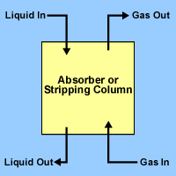
Absorption
Absorption is a process in which a gaseous pollutant is dissolved in a liquid.
Water is the most commonly used absorbent liquid.
As the gas stream passes through the liquid, the liquid absorbs the gas.
Typical Packed Column Diagram
The most common industrial adsorbents are activated carbon, silica gel, and alumina, because they have enormous surface areas per unit weight.
Activated carbon is the universal standard for purification and removal of trace organic contaminants from liquid and vapor streams.

Slide 18
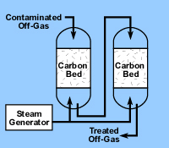
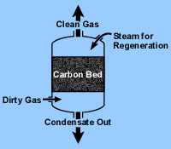
Carbon adsorption systems are either regenerative or non-regenerative.
  Regenerative system usually contains more than one carbon bed. As one bed actively removes pollutants, another bed is being regenerated for future use.
  Non-regenerative systems have thinner beds of activated carbon. In a non-regenerative adsorber, the spent carbon is disposed of when it becomes saturated with the pollutant.
Regenerative Carbon Adsorption System
Non-Regenerative Carbon Adsorption System

Slide 19
Condensation
Condensation is the process of converting a gas or vapor to liquid. Any gas can be reduced to a liquid by lowering its temperature and/or increasing its pressure.
Condensers are typically used as pretreatment devices. They can be used ahead of absorbers, absorbers, and incinerators to reduce the total gas volume to be treated by more expensive control equipment. Condensers used for pollution control are contact condensers and surface condensers.

Slide 20
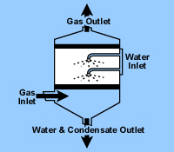
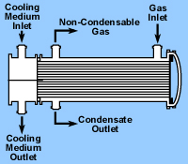
In a contact condenser, the gas comes into contact with cold liquid.
In a surface condenser, the gas contacts a cooled surface in which cooled liquid or gas is circulated, such as the outside of the tube.
Removal efficiencies of condensers typically range from 50 percent to more than 95 percent, depending on design and applications.
Contact condenser
Surface condenser

Slide 21
Incineration
Incineration, also known as combustion, is most used to control the emissions of organic compounds from process industries.
This control technique refers to the rapid oxidation of a substance through the combination of oxygen with a combustible material in the presence of heat.
When combustion is complete, the gaseous stream is converted to carbon dioxide and water vapor.
Equipment used to control waste gases by combustion can be divided in three categories:
  Direct combustion or flaring,
  Thermal incineration and
  Catalytic incineration.

Slide 22
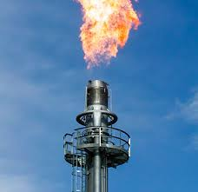
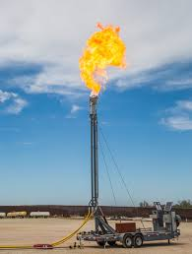
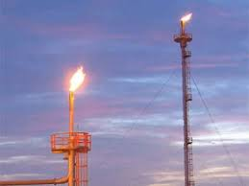
Direct combustor
Direct combustor is a device in which air and all the combustible waste gases react at the burner. Complete combustion must occur instantaneously since there is no residence chamber.
A flare can be used to control almost any emission stream containing volatile organic compounds. Studies conducted by EPA have shown that the destruction efficiency of a flare is about 98 percent.

Slide 23
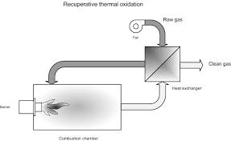
In thermal incinerators the combustible waste gases pass over or around a burner flame into a residence chamber where oxidation of the waste gases is completed.
Thermal incinerators can destroy gaseous pollutants at efficiencies of greater than 99 percent when operated correctly.
Thermal incinerator general case

Slide 24
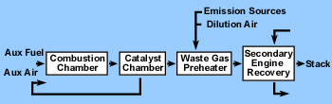
Catalytic incinerators are very similar to thermal incinerators. The main difference is that after passing through the flame area, the gases pass over a catalyst bed.
A catalyst promotes oxidation at lower temperatures, thereby reducing fuel costs. Destruction efficiencies greater than 95 percent are possible using a catalytic incinerator.
Catalytic incinerator

